Slide 1
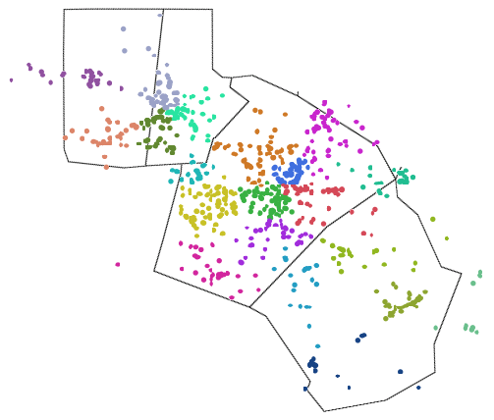
Estimating food waste of grocery stores in Raleigh
1170 grocery stores listed in four main counties
In the US we throw away 13 billion pounds of food at grocery stores, restaurants, and vendors
Orange
Durham
What is the saved food potential in the RTP area from groceries alone?
Wake
Johnston

Slide 2
Where does waste come from?
Liability
Logistics
Overstock
Woo quality

Slide 3
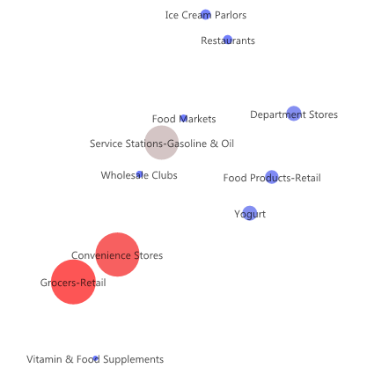
Considerations for partnerships
11 types of store with different waste and partnership potential
Some participate in donation already
Some need alternative programs (what to do with breweries)

Slide 4
Success stories: Food Finders and United Way

